Slide 1
Bùi Xuân Hải
HE200952
Project 1:
4-​bit RISC CPU

Slide 2
Architecture Overview
4-Bit RISC CPU: A streamlined 4-bit processor designed for optimal hardware efficiency.
Harvard Architecture: Physically separate Instruction Memory (ROM) and Data Memory (RAM) to enable simultaneous access and prevent bottlenecks.
3-Stage Pipeline: Enhances instruction throughput by overlapping operations across three stages: Fetch (IF), Decode (ID), and Execute (EX).

Slide 3
Instruction Set Architecture (ISA)
12-Bit Instruction Format:
[11:8] Opcode (4-bit)
[7:6] Rd - Destination Register (2-bit)
[5:4] Rs - Source Register (2-bit)
[3:0] Imm/Addr - Immediate / Address (4-bit)
Three Basic Instruction Categories:
Arithmetic & Logic: ADD, SUB, AND, OR, XOR, NOT
Data Transfer & Memory: LOAD, STORE, LDI, MOV
Control Flow (Branching): JMP, JZ (Jump if Zero)

Slide 4
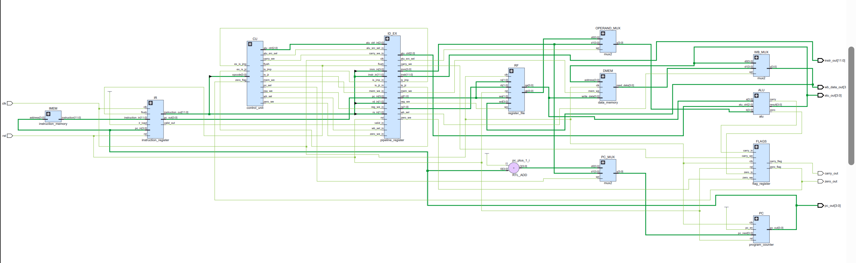
Overall CPU Datapath (3-Stage Pipeline)

Slide 5
Overall CPU Datapath (3-Stage Pipeline)
Stage 1: Instruction Fetch (IF)
PC provides address ->IMEM outputs instruction ->Saved to IR (IF/ID).
Stage 2: Instruction Decode (ID)
CU decodes Opcode into Control Signals.
RF (Register File) prepares source data.
Data is latched into the ID_EX pipeline register.
Stage 3: Execute & Write-Back (EX)
ALU executes arithmetic/logic operations.
DMEM handles memory access (Load/Store).
MUXes route results for Write-back or Branching.

Slide 6
Details of the 3-Stage Pipeline
Stage 1: Instruction Fetch (IF)
Retrieves the 12-bit instruction from Instruction Memory (ROM).
Updates the Program Counter (PC) for the next cycle.
Stage 2: Instruction Decode (ID)
Translates the Opcode into execution Control Signals.
Reads source data from the Register File.
Stage 3: Execute & Write-Back (EX)
Performs arithmetic and logic calculations (ALU).
Executes Memory Load/Store operations.
Writes results back to the destination register.

Slide 7
Handling Branch Instructions (Pipeline Flush)
The Issue:
When a Jump instruction (JMP or JZ) is executed, the CPU changes its path.
However, the pipeline has already pre-fetched the next two sequential instructions.
The Solution: Pipeline Flush
The Control Unit detects the jump and activates a flush signal.
This clears the wrong instructions in the pipeline (replacing them with NOP / bubbles).
The CPU then fetches from the correct new address.

Slide 8
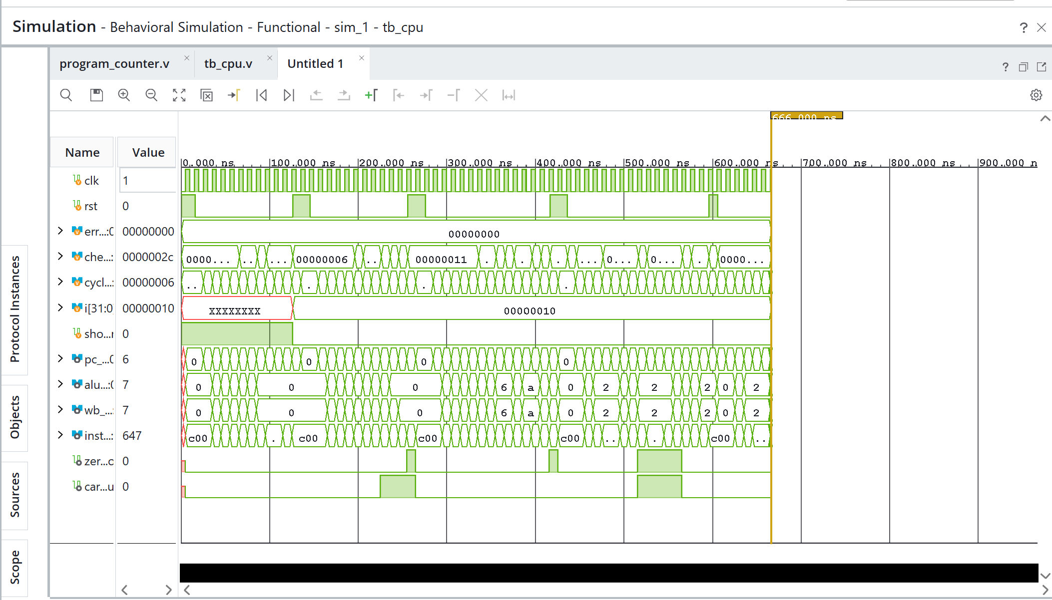
System Verification: Waveform Results

Slide 9
System Verification: Waveform Results
5 Automated Test Phases: Clearly visible via the rst (reset) signal spikes.
Flawless Execution:
The errors signal remains strictly at 00000000.
The checks counter successfully reaches 0x2C (44 passed tests).
Visual Proof of Pipeline Flush:
c00 (NOP / Bubbles) can be seen injected into the instr_out stream during resets and jumps.

Slide 10
Thank you for listening

